Slide 1
Lecture 9: Empirical orthogonal functions

Slide 2
Discussion topics:
Empirical Orthogonal Function (EOF) analysis
Exploratory vs. confirmatory factor analysis

Slide 3
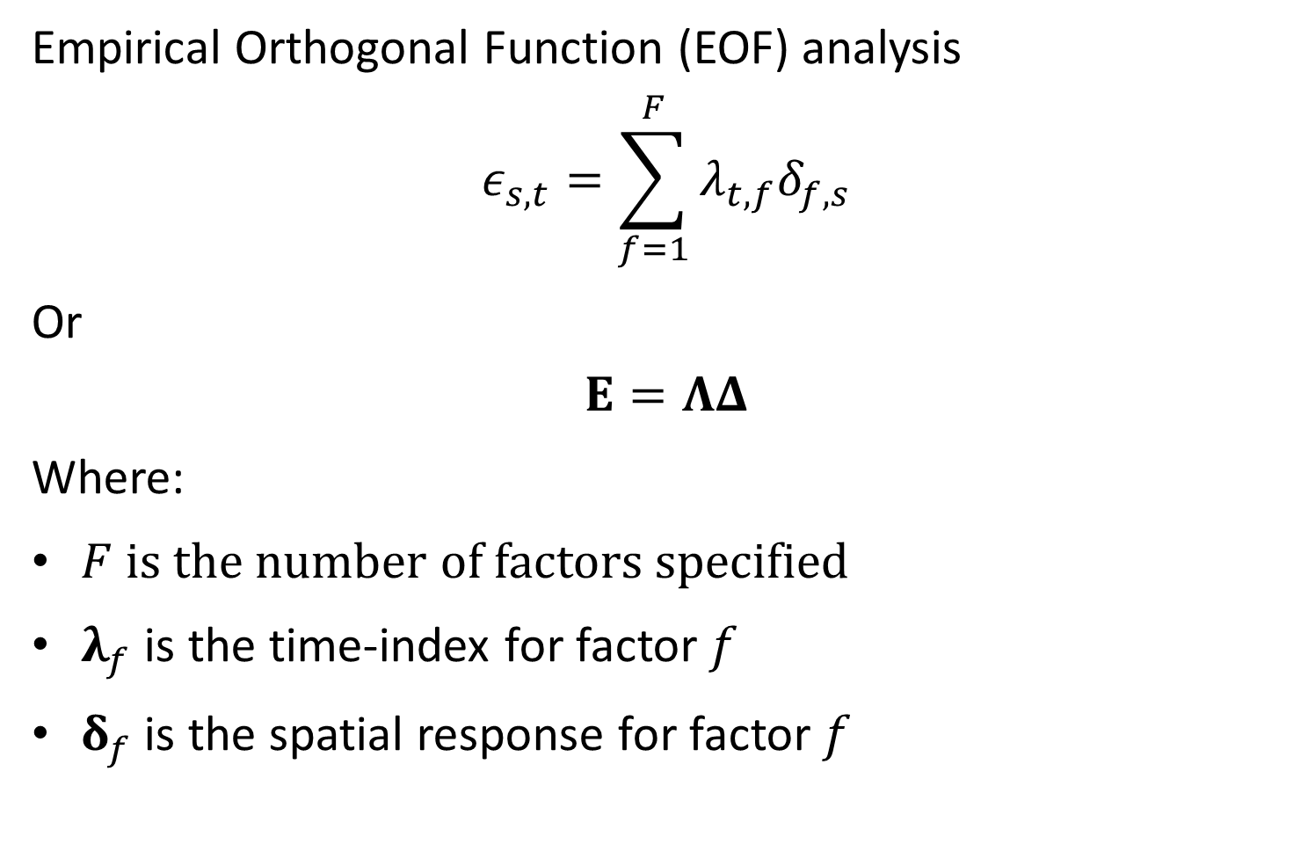
Empirical Orthogonal Function (EOF) analysis
$$ε_{s,t}=\sum_{f=1}^{F}{λ_{t,f}δ_{f,s}}$$
Or
$$E=ΛΔ$$
Where:
$F$ is the number of factors specified
$λ_{f}$ is the time-index for factor $f$
$δ_{f}$ is the spatial response for factor $f$

Slide 4
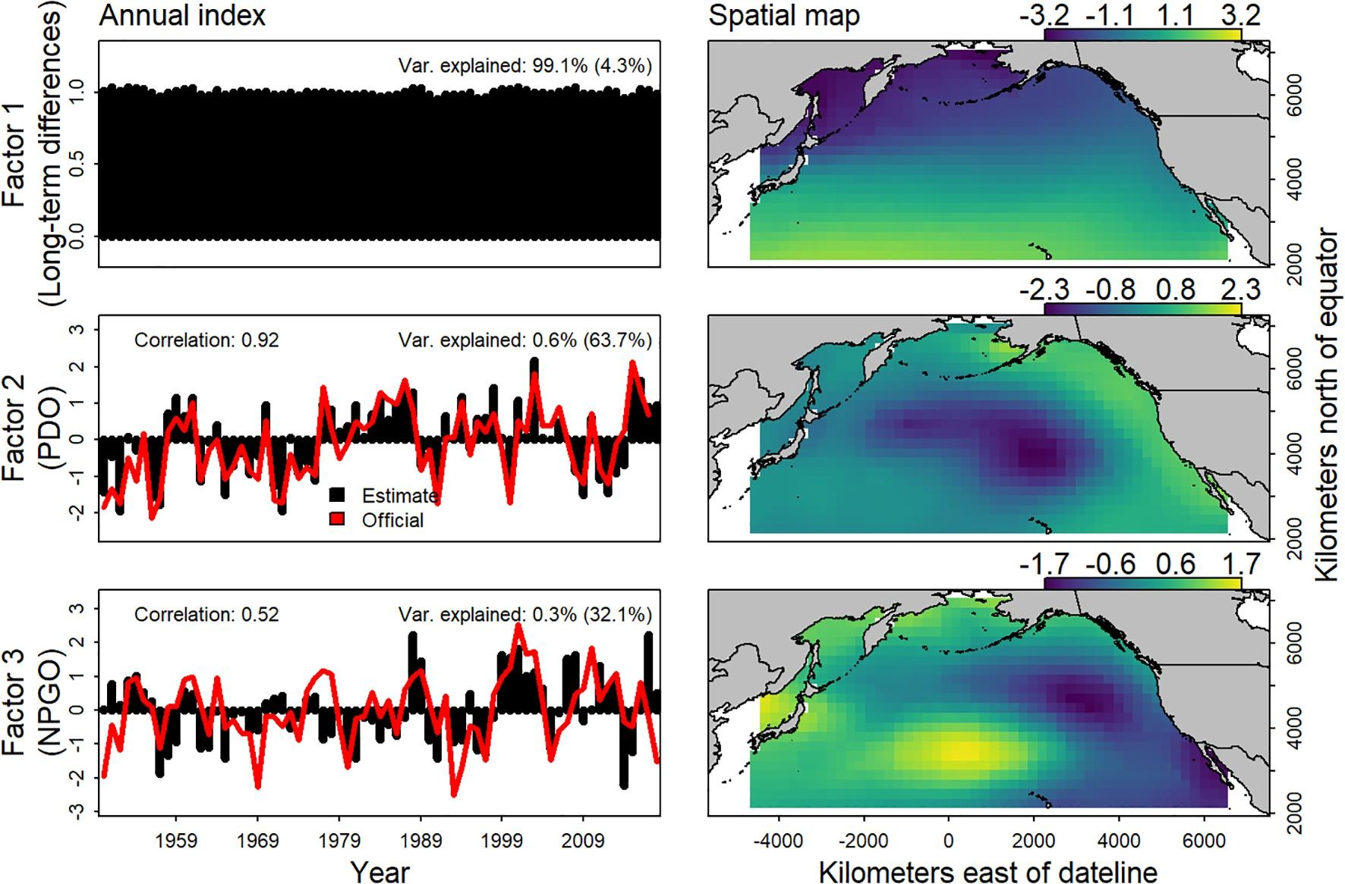
Thorson, J. T., L. Ciannelli, and M. A. Litzow. 2020. Defining indices of ecosystem variability using biological samples of fish communities: A generalization of empirical orthogonal functions. Progress in Oceanography 181:102244.

Slide 5
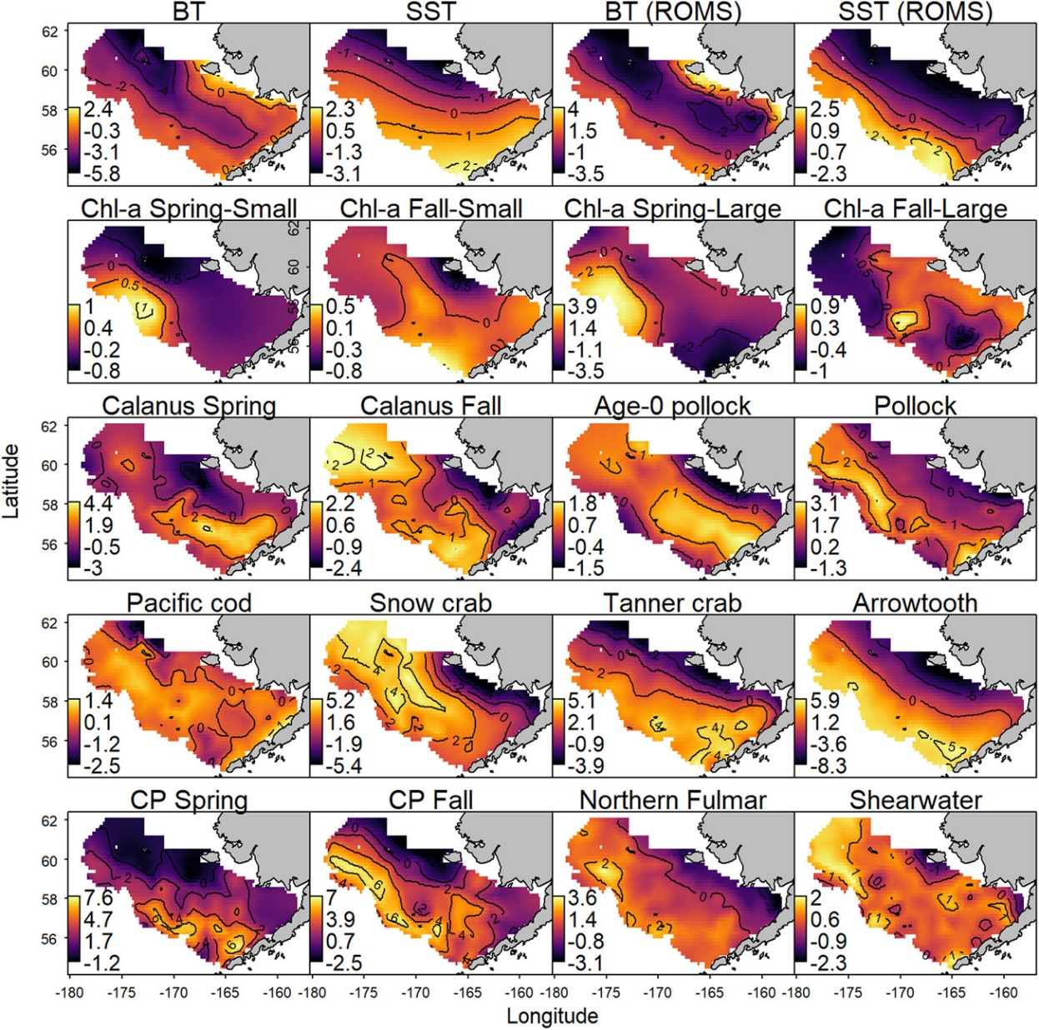
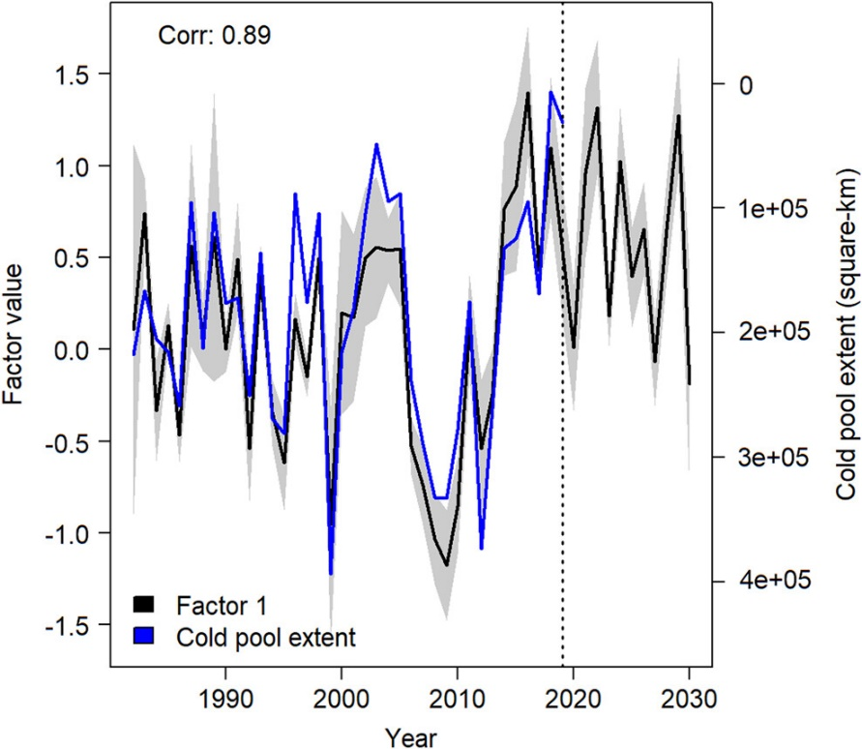
Spatial responses for 20 spatial variables
Dominant mode of variability for ecosystem components in the eastern Bering Sea
Thorson, J. T., M. L. Arimitsu, L. A. K. Barnett, W. Cheng, L. B. Eisner, A. C. Haynie, A. J. Hermann, K. Holsman, D. G. Kimmel, M. W. Lomas, J. Richar, and E. C. Siddon. 2021. Forecasting community reassembly using climate-linked spatio-temporal ecosystem models. Ecography 44:612–625.

